Slide 1
FPGA Design Project
Notes:
Hi Everybody,

Slide 2
STUDENT A 1) SETUP

Slide 3
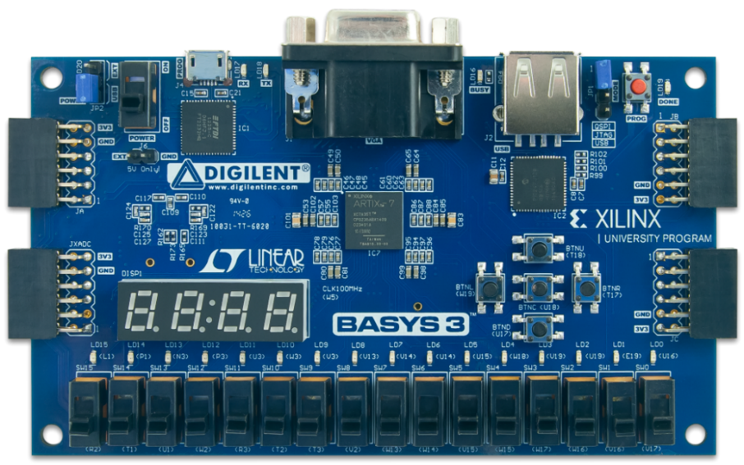
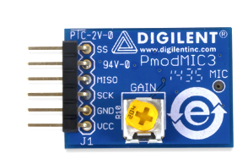
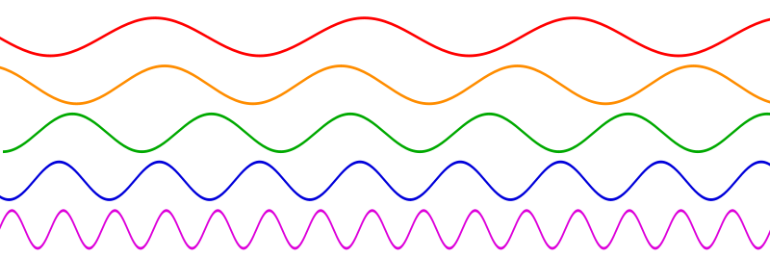

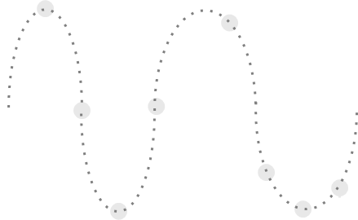
Student A - Microphone
0.5V
0.8V
0.3V
0V
0V
1V
0.95V
0.5V
0.5V
0.2V
Notes:
By now, you know that the FPGA is a digital system and only produces two different voltage levels. A signal generator needs to produce many different voltages.
To do this, we will be using a special additional on board that contains a D A C, or digital to analog converter.
The DAC allows us to convert a multi bit digital value into an analog signal.
Lets look at it in greater detail.

Slide 4
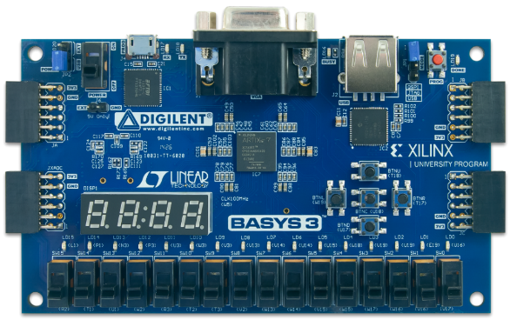
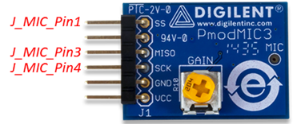
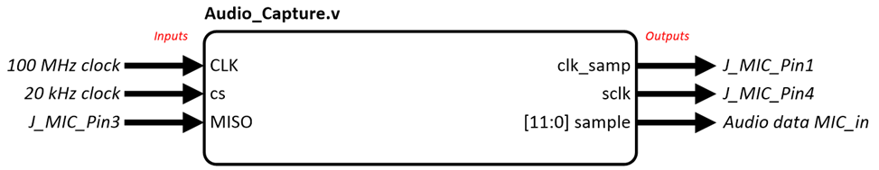
Student A -Lab Tasks Today
Download Template
Instantiate Audio_Capture
Create & link 100MHz clock
Create & link 20kHz clock
mic_in is the digital audio data captured from mic!
Note that mic_in data is centered at 2048.
Link J_MIC_Pin1/3/4
LEDs all turn on / flicker!

Slide 5
STUDENT B 1) SETUP

Slide 6
Student B -Lab Tasks Today
Download Template
Instantiate Oled_Display
Create & link 6.25MHz clock
Create 16-bit reg & link to Oled_Display oled_data = 16’h07E0;
Link JX[0:7].
Set reset to 0. Other signals leave blank!
See green screen! Try other colours!
R | G | B
00000 | 111111 | 00000

Slide 7
STUDENT A+B SETUP

Slide 8
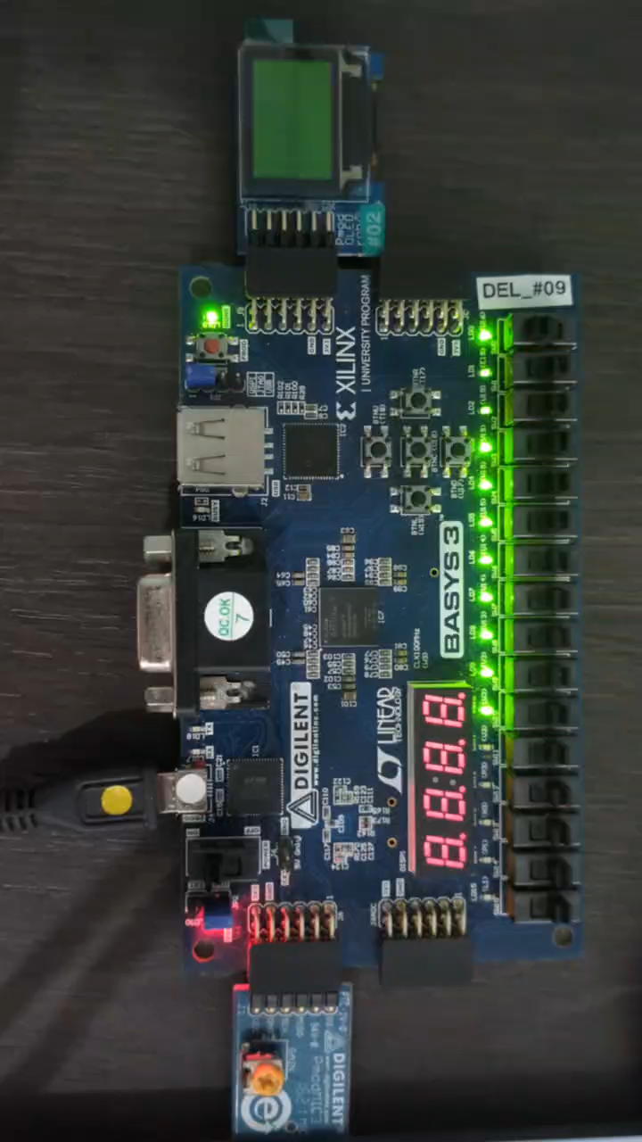
SA + SB Combined

Slide 9
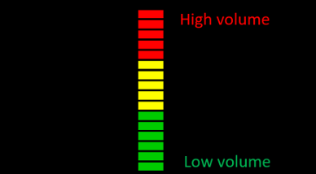
SUGGESTED FEATURES AS STARTING POINT
A : REAL-TIME AUDIO VOLUME INDICATOR
B : VOLUME BARS AND BORDERS DISPLAY
Notes:
Oscilloscope → signal generator

Slide 10
STUDENT A

Slide 11
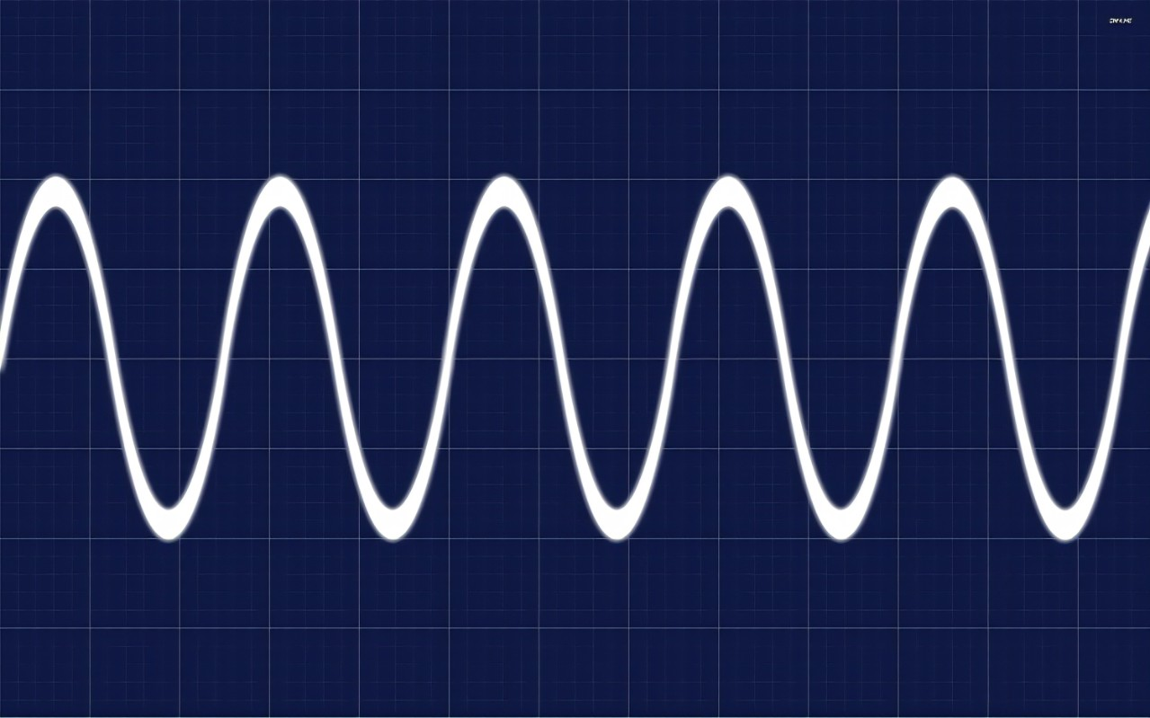

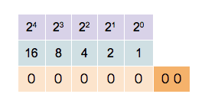
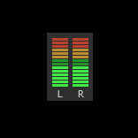
Binary to Linear Conversion :
What is VOLUME? – SUGGESTED FEATURE
The volume of a signal is reflected in its amplitude
To find volume, we need to find amplitude over a time interval
Convert binary to linear for easy display

Slide 12
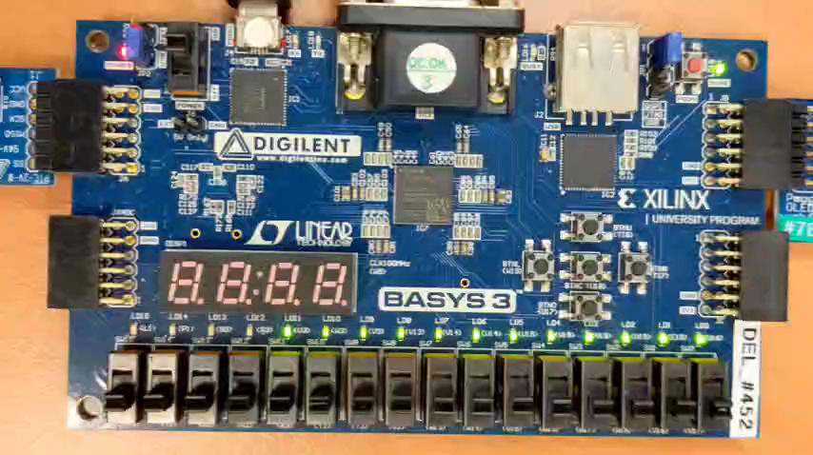
STUDENT A

Slide 13
STUDENT B

Slide 14
Student B - OLED
pixel_index (0 to 6143) → coordinate
oled_data (0 to 16’hFFFF) → colour
96*64 pixel = 6144 pixels
horiz, vert
(96 px)
0
0
1..
0
3..
0
0..
1..
2
2
x
0 → 95
y
(64 px)
oled_data
R | G | B
0 → 63
00000 | 000000 | 00000
11111 | 000000 | 00000
11111 | 000000 | 11111
00000 | 000011 | 00000
Notes:
oled_data

Slide 15
How do we draw lines / shapes?
x
0 → 95
x
y
y
oled_data
0 → 63
R | G | B
_____ | ______ | _____
16’b00000_000000_11111
assign oled_data = (x == 6’b000000) ? 16’h001F : 16’h0000;
assign oled_data = (y == 6’b000000) ? 16’h001F : 16’h0000;
assign oled_data = (x == 6’b000000 || y == 6’b000000) ? 16’h001F : 16’h0000;

